Slide 1
DISK CLONING
Definition
Disk cloning is the process of creating an exact copy of a storage device including its operating system, programs, files and configurations

Slide 2
BEFORE WE BEGIN
Backup of data: before starting disk cloning, it is always good to backup data to an external hard drive.
Download the disk genius software: head to the download page of disk Genius and got to downloads and download it. The software is free and doesn’t need any subscription.
Make sure the Disk D is having enough space to accommodate all the files from disk C or greater: It is also good to make sure that this disk is empty or has data/files that are not very important as it will be lost in the cloning process later.

Slide 3
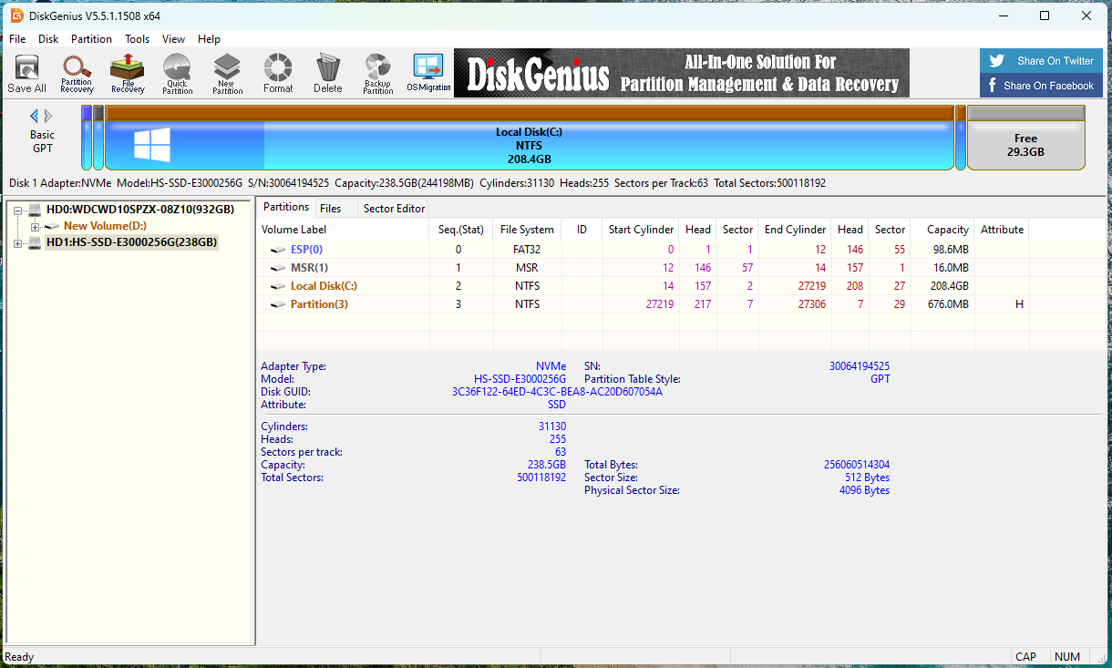
INSTALLING DISK GENIUS
After successfully downloading disk genius, double click on it to start the installation process.
Follow the instructions on the installation wizard.
Finally it will open.

Slide 4
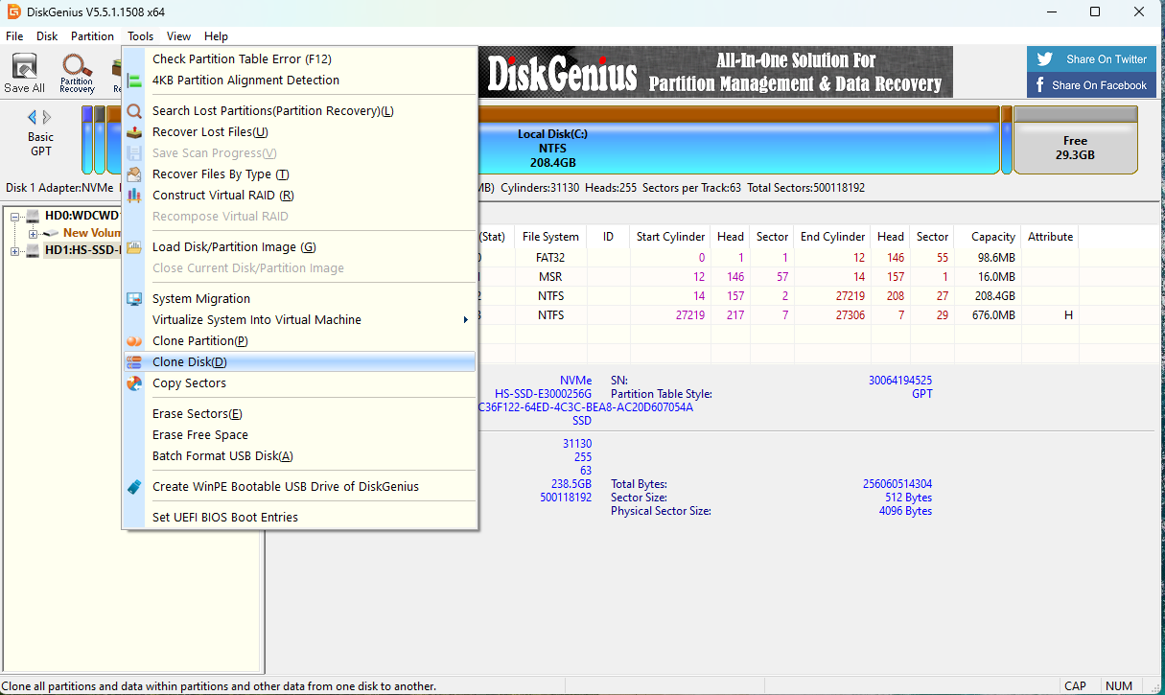
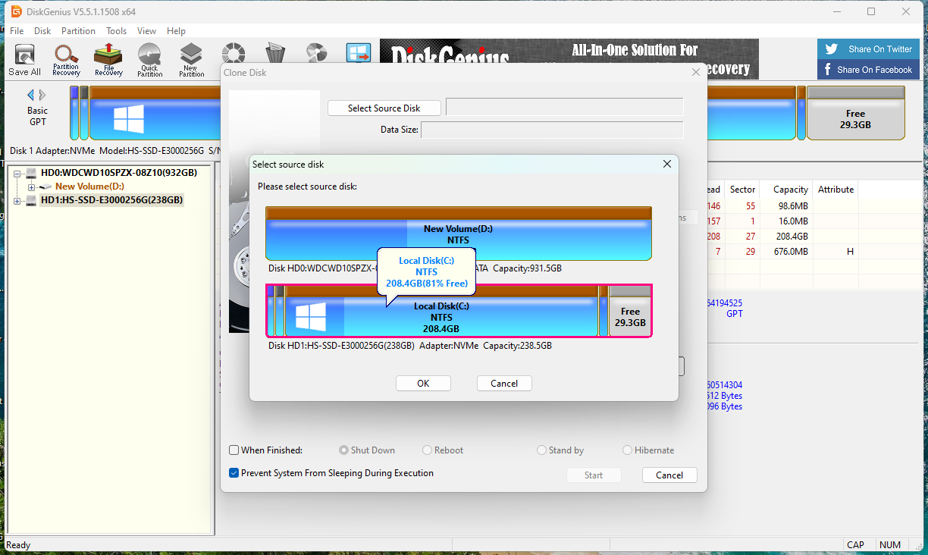
CLONING WITH DISK GENIUS
2. Click on tools and in the drop down choose disk cloning
1. Launch disk genius as shown above
3. Then choose the source disk
Based on our question we choose local disk C as source disk

Slide 5
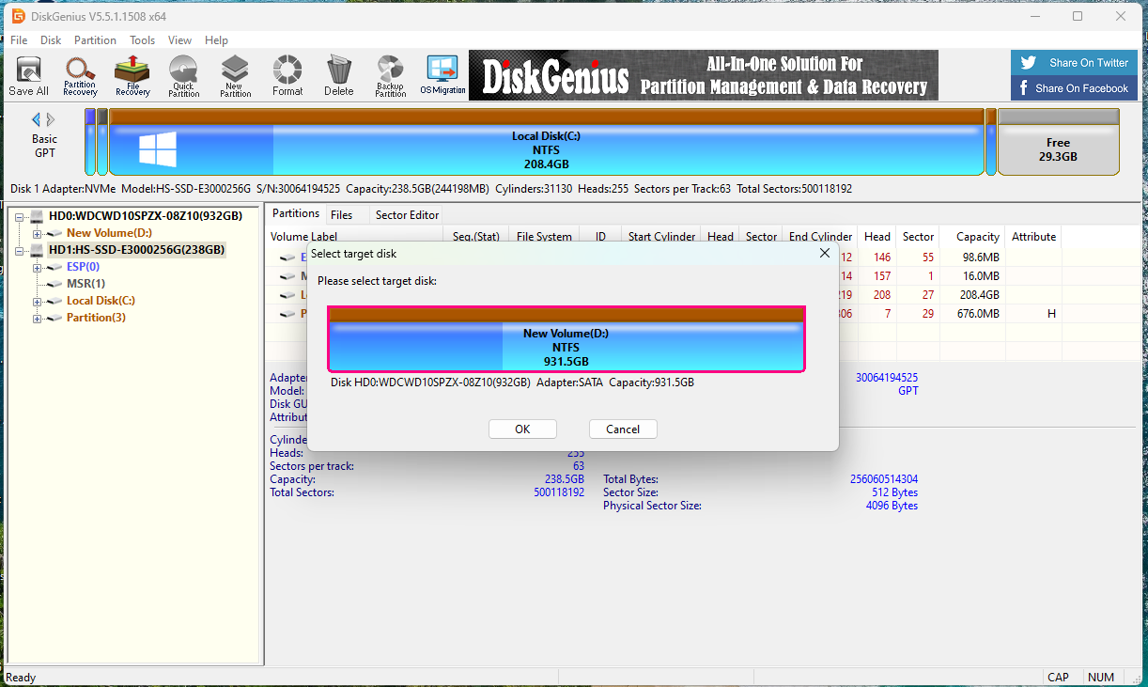
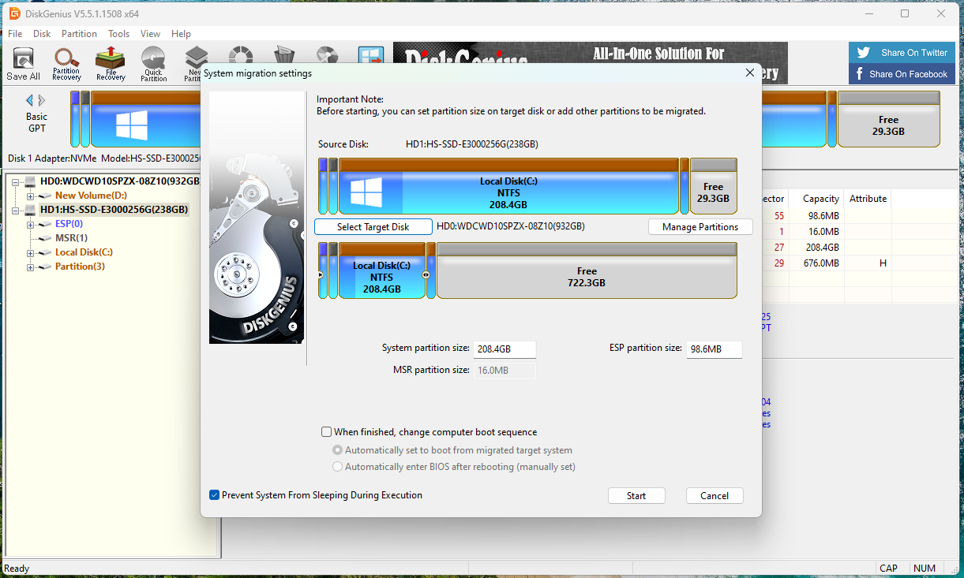
4. Then choose the destination disk. For our case it is local disk D
5. You can decide to adjust the space by dragging the circle in the middle of the disk to cover the whole disk. After all that has been done, click on start to begin the cloning process.

Slide 6
DISK CLONING
Question
Your friend’s local disk C partition is full, while other partitions have ample free space. They need help cloning Disk C to disk D without losing any data or software licenses.
Create a 5-slide presentation demonstration step-by-step how to perform disk cloning including a demonstration

